Slide 1


BANK MARKETING CAMPAIGN OPTIMIZATION
Final Project Presentation - Group 3
-Abhishek Dubey
-Janani Dhanasekara
-Manmohan Dash
-Muneeb Ullah Jan

Slide 2

PROJECT MOTIVATION
Implement the key concepts discussed in class and be able to interpret the results for making business decisions

Slide 3



CONTENT INDEX
Objective
Feature selection
EDA
Data mining analysis
Interpreting the model
Insights & recommendation
Appendix

Slide 4


Objective
AIM: Advise the marketing teams on how to focus more on the prospective clients who would end up making a term deposit
The questions we aim to answer are:
What factors influence whether a marketing campaign will result in customers opening term deposits with the bank?
Based on demographic factors, which customers would be the most suitable to target for the marketing campaign?
Which model would be the most reliable for accurately predicting whether an individual will opt for a term deposit?

Slide 5
Exploratory data analysis
# of clients
Conversion rate (%)

Slide 6
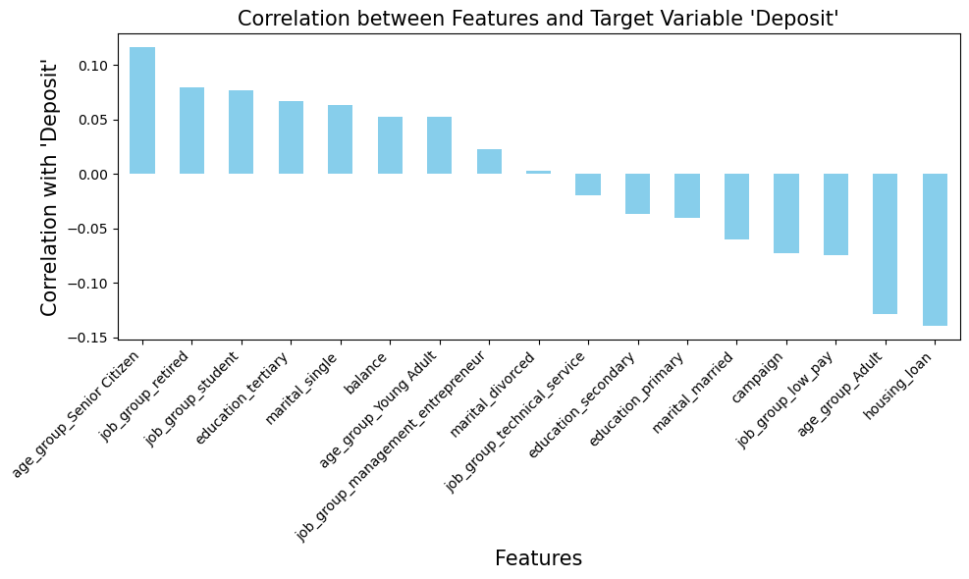
Feature Selection
• Variables highly co-related with the outcome variable introduce biases
• Explanatory variables being co-related among themselves are redundant, should be removed
• Basis of feature removal: Statistics, intuition and business domain knowledge

Slide 7


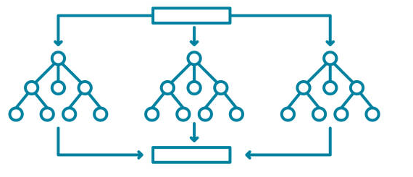
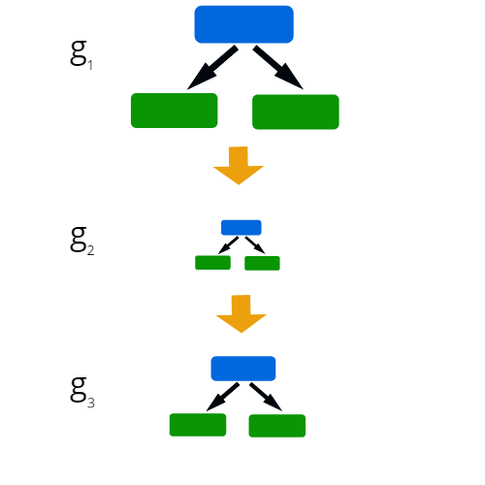
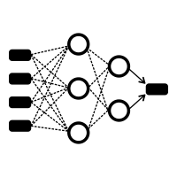
Data Mining Analysis
Deployed Models:
Logistic Regression
Decision Tree
AUC: 0.685
AUC: 0.661
Good score,
and high interpretability
BUSINESS
OBJECTIVE
Random Forest
Adaboost
AUC: 0.697
AUC: 0.696
Champion model, but no interpretability
Neural Network
AUC: 0.617

Slide 8
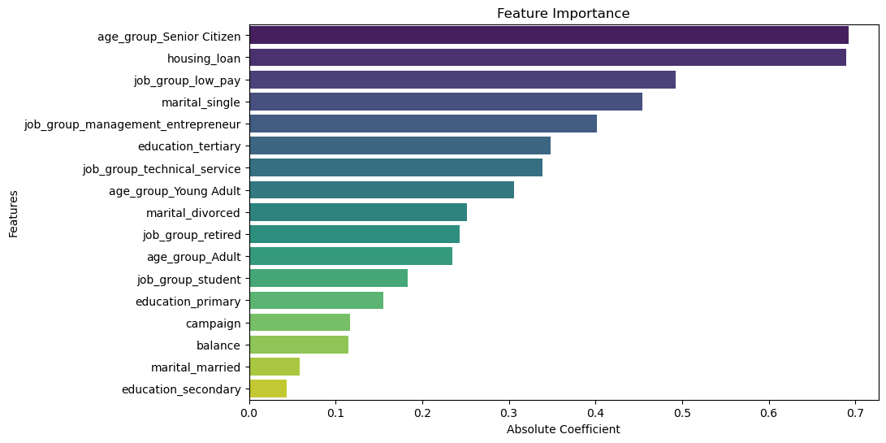
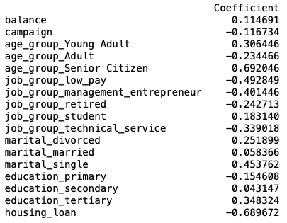
Interpreting the model

Slide 9



Insights & recommendations
T
A R
G
E
T
Senior citizens and retired professionals, being risk-averse, prefer secure investment options like term deposits to minimize risks with their accumulated savings
Individuals with a house loan may prioritize paying off their loan over making term deposits due to their risk aversion and existing financial commitments
Marital singles have more financial freedom without family obligations, enabling them to explore investment options freely
High-paying jobs allow entrepreneurs to take high-risk investments, while low-income individuals prioritize immediate needs over term deposits
Increasing campaign contact frequency can hinder conversion rates. Banks should train marketing staffs to efficiently address customer needs, thereby optimizing contact frequency

Slide 10

THANK YOU

Slide 11
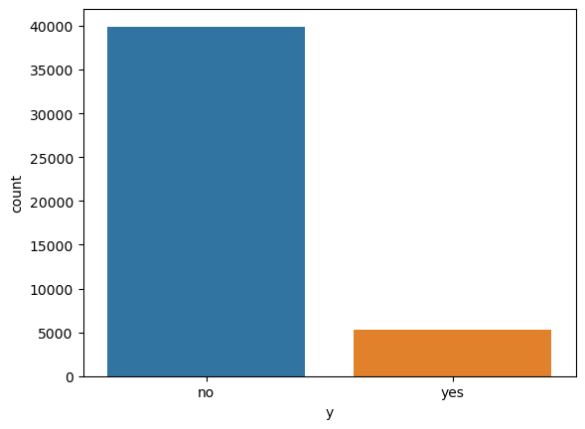
Background
The data is related with direct marketing campaigns of a Portuguese banking institution. The marketing campaigns were based on phone calls
Our dataset has 17 attributes ,~45,000 instances; but highly imbalanced (88%-12%)
Attributes | Type | Description
Age | Numeric | Young Adult, Adult, Senior Citizen
job | Categorical | Management & Entrepreneur, Technical service, Low Pay, Unemployed, Retired, Student
Marital | Categorical | Single, Married, Divorced
Education | Categorical | Primary, Secondary, Tertiary
Default | Categorical | has credit in default
Balance | Numeric | average yearly balance
Loan | Categorical | Loan
Contact | Categorical | Cellular, Telephone
Month | Categorical | Last contact month of year
Campaign | Numeric | No. of contacts performed during the campaign
previous | Numeric | No. of contacts performed before this campaign
Deposit | Categorical (Target) | Has the client subscribed a term deposit

Slide 12
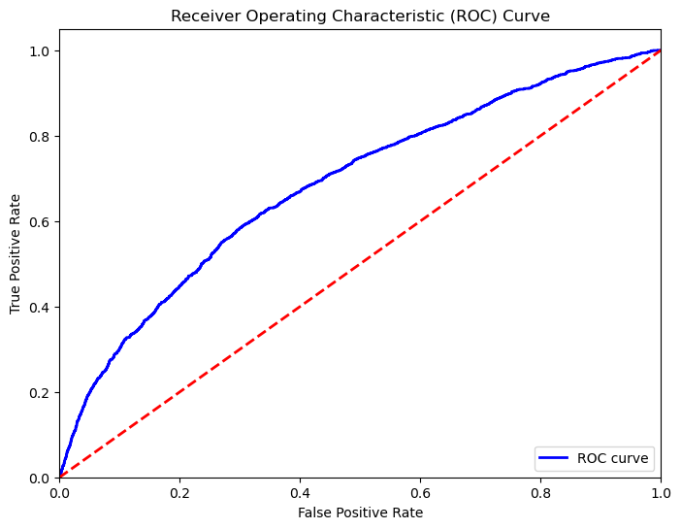
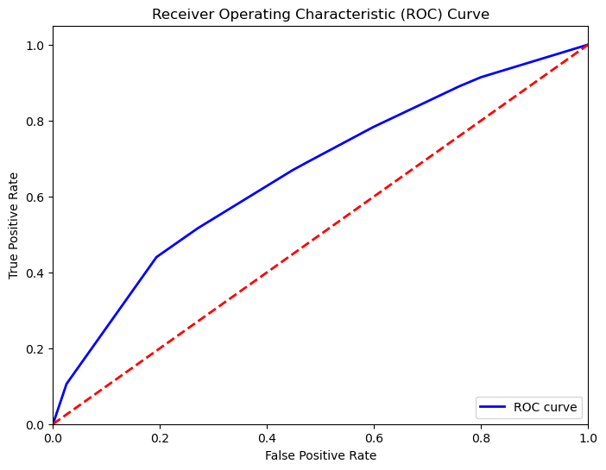
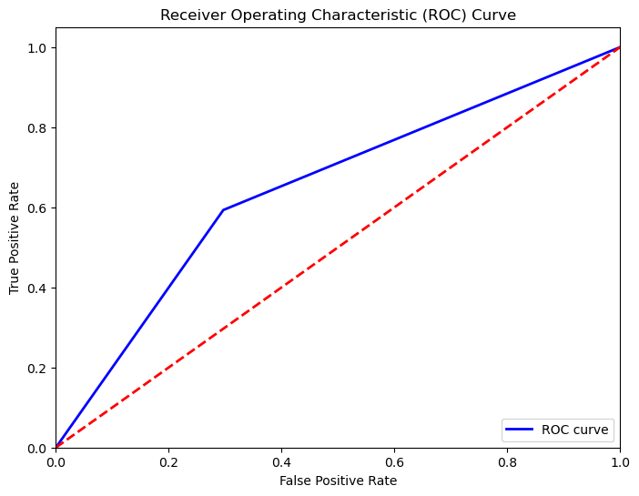
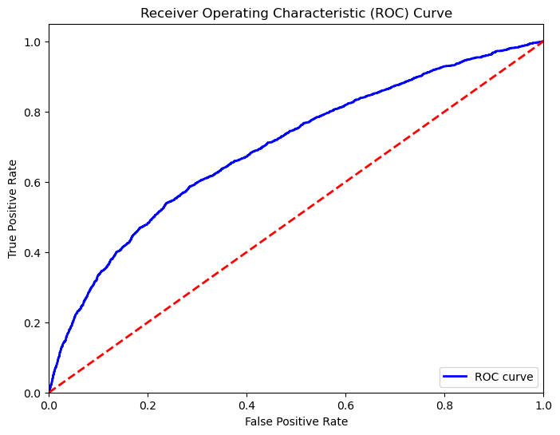
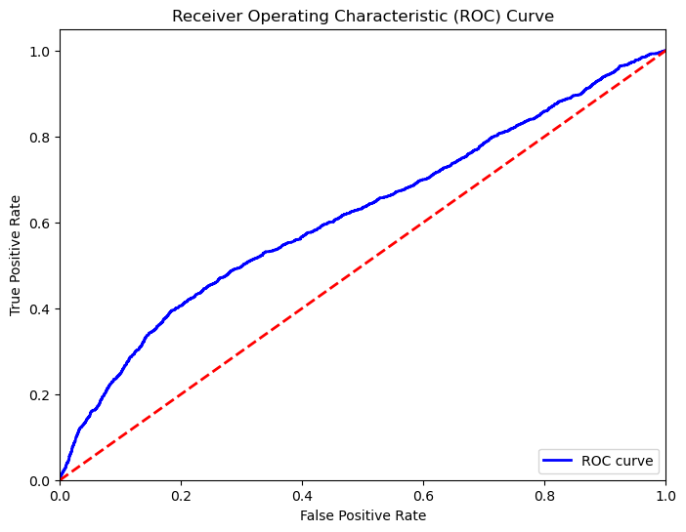
RoC Curves
Logistic Regression (AUC = 0.685)
Decision Tree
(AUC = 0.661)
Random Forest
(AUC = 0.697)
Adaboost
(AUC = 0.696)
Neural Network (AUC = 0.617)

Slide 13
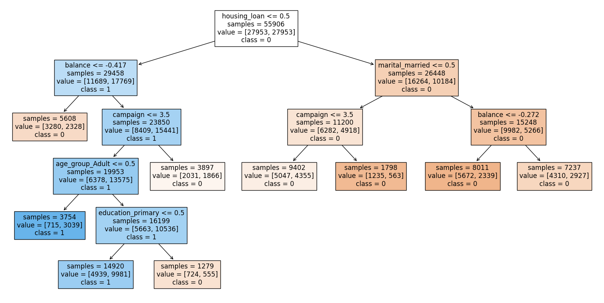
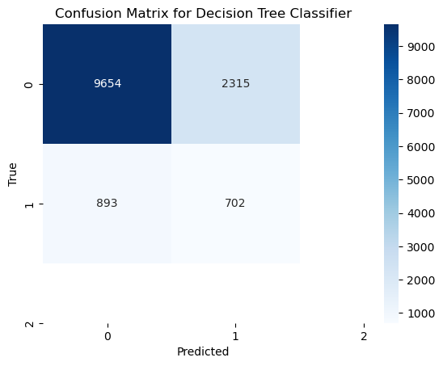
Decision Tree

Slide 14
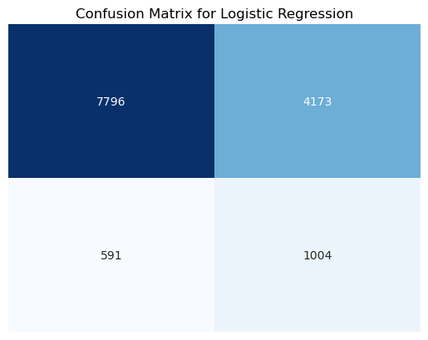
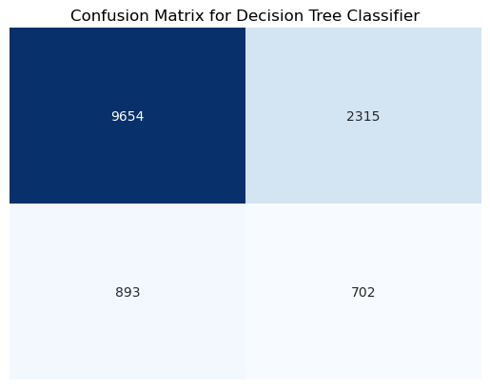
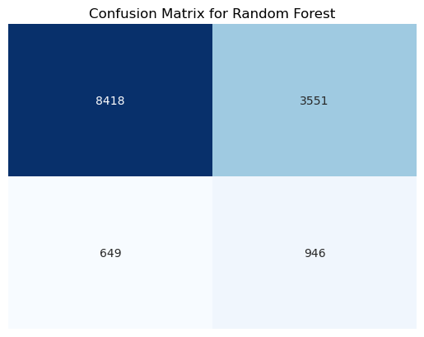
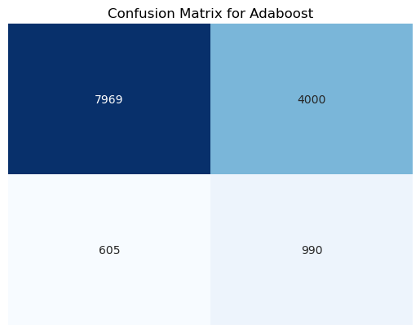
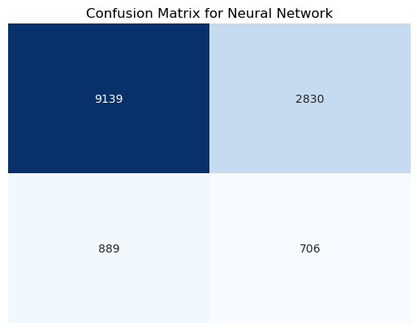
Confusion Matrix
Overall champion model
Min. false positive
TN
FP
TN
FP
TN
FP
FN
TP
FN
TP
FN
TP
Min. false negative
TN
FP
TN
FP
FN
TP
FN
TP

